Slide 1
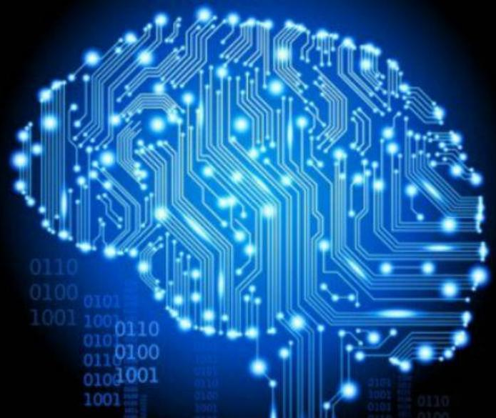
A bit of History

Slide 2
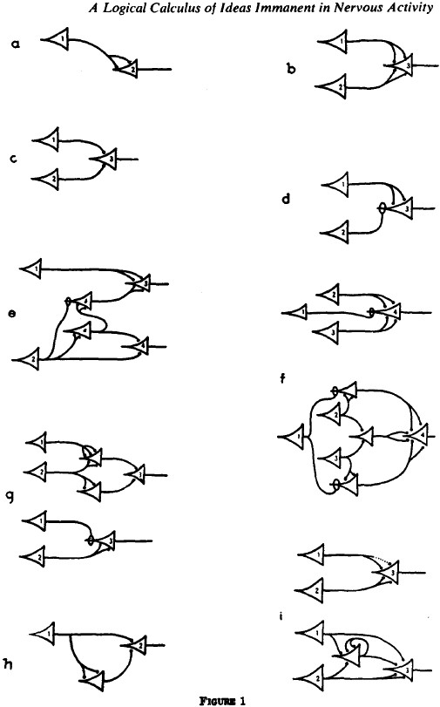
A bit of History
1943 Warren McCulloch & Walter Pitts:
How To: From neurons to complex thought
Binary threshold activations
1949 Howard Hebb:
Neurons that fire together wire together
Weights: Learning and memory
McCullock & Pitts / Hebb
Rosenblatt's Perceptron
Minsky & Papert - XOR
Backpropagation Algorithm
[McCullock, 43]

Slide 3
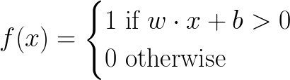
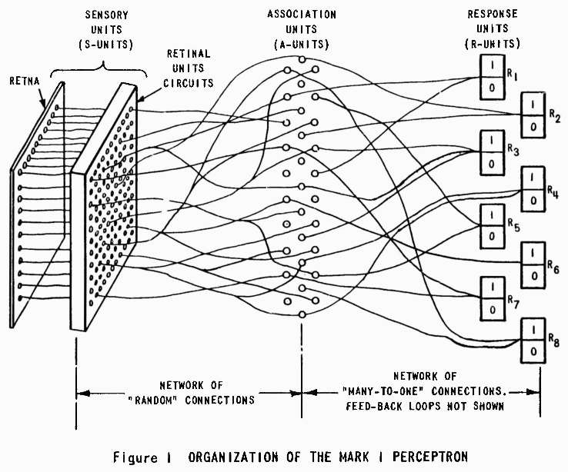
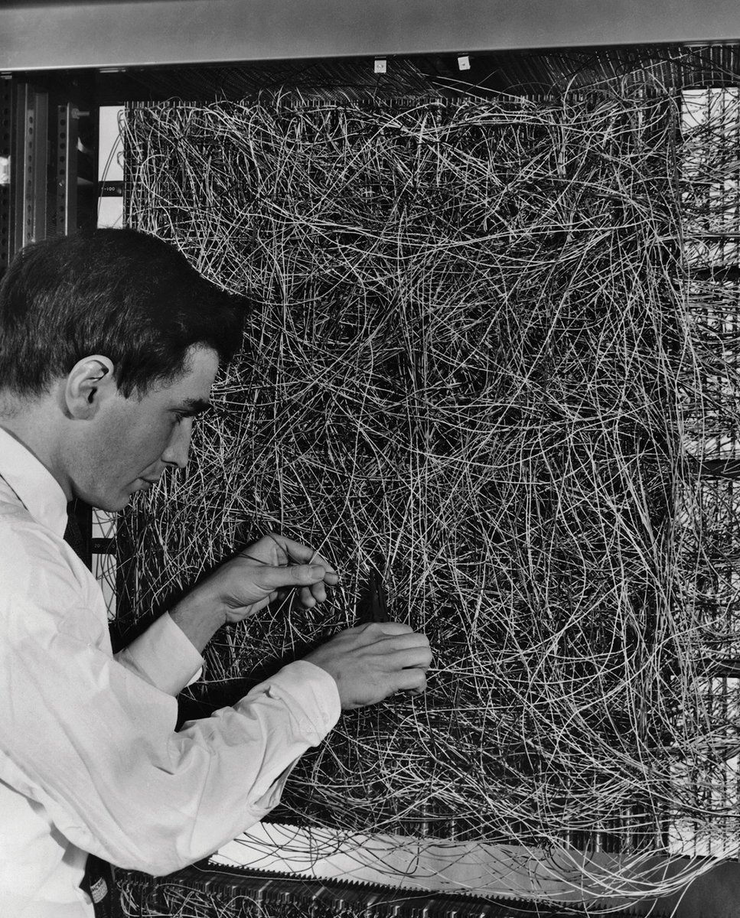
A bit of History
1948, Rosenblatt applied Hebb's learning to McCulloch & Pitts design
w real-valued weights
· dot product
b real scalar constant
The Mark I Perceptron. A visual classifier with:
400 photosensitive receptors (sensory units)
512 stepping motors (association units, trainable)
8 output neurons (response units)
McCullock & Pitts / Hebb
Rosenblatt's Perceptron
Minsky & Papert - XOR
Backpropagation Algorithm
[Rosenblatt, 58]
[Mark I Perceptron]
[Perceptrons]
[1]

Slide 4
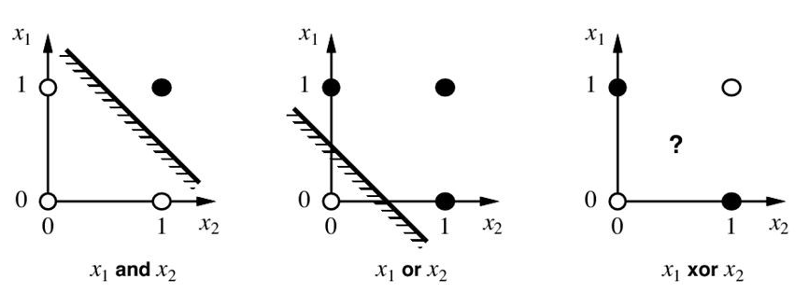
A bit of History
Rosenblatt acknowledged a set of limitations in the Perceptron machine.
Minsky & Papert did too in “Perceptrons: an introduction to computational geometry”, including:
A multilayer perceptron (MLP) is needed for learning basic functions like XOR
MLP cannot be trained.
McCullock & Pitts / Hebb
Rosenblatt's Perceptron
Minsky & Papert - XOR
Backpropagation Algorithm
This had a huge impact on the public, resulting in a drastic cut in funding of NNs until the mid 80s
1st AI WINTER
[Minsky, 69]

Slide 5
A bit of History
How can we optimize neuron weights which are not directly connected to the error measure?
Backpropagation algorithm:
Use the chain rule to find the derivative of cost with respect to any variable.
In other words, find the contribution of each weight to the overall error.
First proposed for training MLPs by Werbos in '74.
Rediscovered by Rumelhart, Hinton and Williams in '85.
End of NNs Winter
Training with backprop
Forward pass from input to output
Error measurement (loss function)
Find gradients towards minimizing error layer by layer (backward pass)
McCullock & Pitts / Hebb
Rosenblatt's Perceptron
Minsky & Papert - XOR
Backpropagation Algorithm
[Werbos,74]
[Rumelhard,85]

Slide 6
Feedforward Neural Networks

Slide 7
Feedforward Neural Networks
Computing the gradients using all available training data would require huge amounts of memory.
Stochastic Gradient Descent: Iteratively update weights using random samples (hence, stochastic)
Each feedforward/backward cycle (a step) processes a random batch of images.
Typical batch sizes: Powers of 2.
Batch size = 1 --> Full stochastic (slower)
Batch size = dataset_size --> Deterministic (bad generalization)
An epoch is the processing of the whole dataset once. It corresponds to processing as many batches as:
dataset_size / batch_size
SGD, Epochs, Batches and Steps
Activation functions
SGD learning rate
Other optimization methods
Regularization
Normalizing inputs
Vanishing/Exploding Gradients
Weights initialization

Slide 8
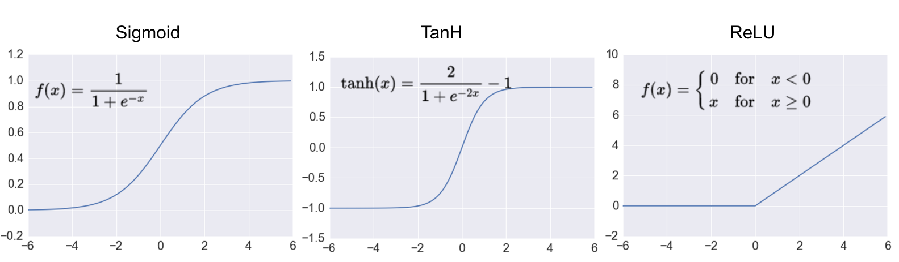
Feedforward Neural Networks
Activation functions transform the output of a layer to a given range. If the function is non-linear, the net can learn non-linear patterns (e.g., XOR).
SGD, Epochs, Batches and Steps
Activation functions
SGD learning rate
Other optimization methods
Regularization
Normalizing inputs
Vanishing/Exploding Gradients
Weights initialization
Zero gradient in most of f(x). Saturates!
Max gradient is 0.25 or 1. Vanishing!
Does not saturate
Does not vanish
Faster
May die
ReLU is a safe choice in most cases
Undying alternatives: Leaky ReLU, ELU, ...

Slide 9

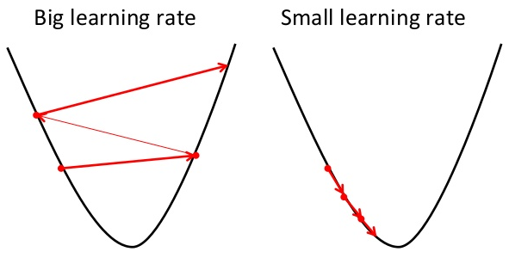
Feedforward Neural Networks
Gradient descent is a simple and straight-forward optimization algorithm to update weights towards a min.
Learning rate determines how much we move in that direction. With the wrong LR you may end up in local minima or saddle points, or be too slow.
SGD will overshoot unless we keep decreasing the LR.
SGD, Epochs, Batches and Steps
Activation functions
SGD learning rate
Other optimization methods
Regularization
Normalizing inputs
Vanishing/Exploding Gradients
Weights initialization
[Dauphin, 14]

Slide 10
Feedforward Neural Networks
Momentum: Include a fraction of the previous gradient. Keeps the general direction so far.
Nesterov: Compute current gradient considering where the previous gradient took you. (RNNs?)
Adagrad: Parameter-wise LR considering past updates. Good for infrequent patterns (GloVe). Vanishing LR due to growing history.
Adadelta: Adagrad with a decaying average over history. Typically set around 0.9.
Adam: Adadelta + Momentum
SGD, Epochs, Batches and Steps
Activation functions
SGD learning rate
Other optimization methods
Regularization
Normalizing inputs
Vanishing/Exploding Gradients
Weights initialization
[Dauphin, 14]
[Ruder,www]

Slide 11
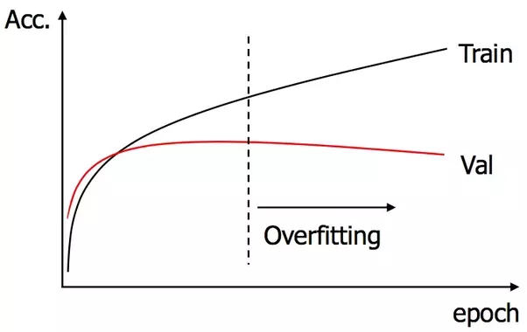
Feedforward Neural Networks
Why do we need regularization?
Because the difference between Machine Learning and Optimization is called Generalization
SGD, Epochs, Batches and Steps
Activation functions
SGD learning rate
Other optimization methods
Regularization
Normalizing inputs
Vanishing/Exploding Gradients
Weights initialization

Slide 12
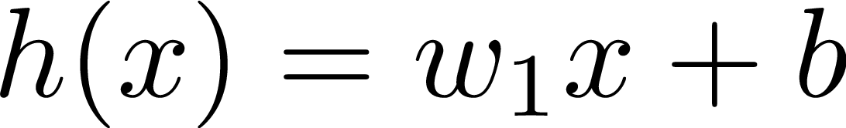
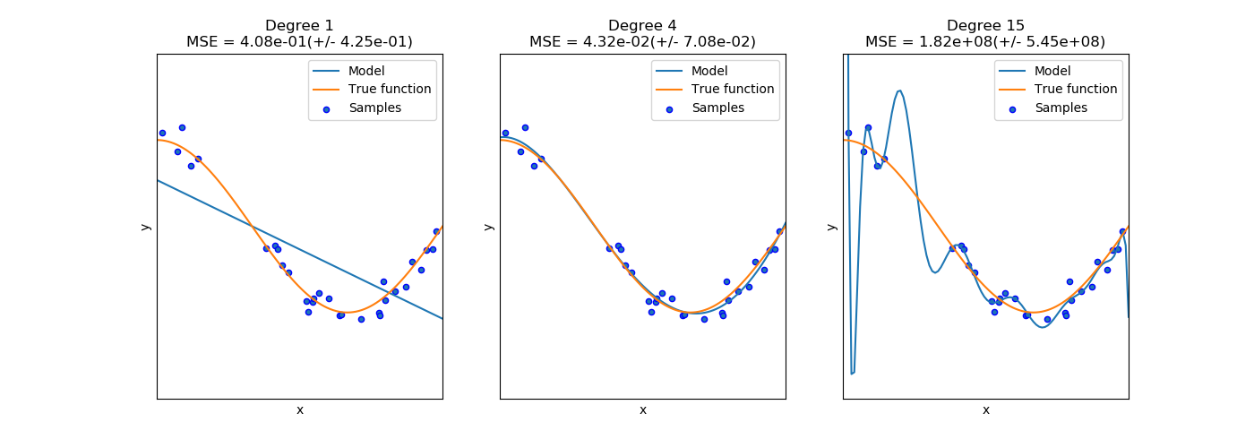
Feedforward Neural Networks
Generalization
Polynomial regression
1
2
3
SGD, Epochs, Batches and Steps
Activation functions
SGD learning rate
Other optimization methods
Regularization
Normalizing inputs
Vanishing/Exploding Gradients
Weights initialization
1
2
3

Slide 13
Feedforward Neural Networks
Generalization
Polynomial regression
Training Error
Huge
Small
Tiny
Model Generalization
SGD, Epochs, Batches and Steps
Activation functions
SGD learning rate
Other optimization methods
Regularization
Normalizing inputs
Vanishing/Exploding Gradients
Weights initialization
Bad
Good
Horrible

Slide 14

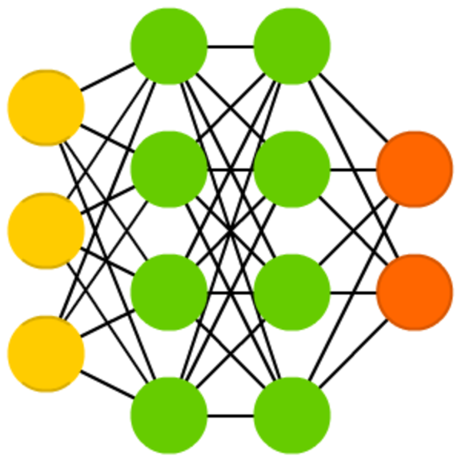
Feedforward Neural Networks
Generalization
What policy can we use to improve model generalization?
Occam’s Razor
when you have two competing hypotheses
that make the same predictions,
the simpler one is the better
SGD, Epochs, Batches and Steps
Activation functions
SGD learning rate
Other optimization methods
Regularization
Normalizing inputs
Vanishing/Exploding Gradients
Weights initialization
Machine Learning
given two models
that have a similar performance,
It’s better to choose the simpler one

Slide 15
Feedforward Neural Networks
Model Complexity
What policy can we use to improve model generalization?
SGD, Epochs, Batches and Steps
Activation functions
SGD learning rate
Other optimization methods
Regularization
Normalizing inputs
Vanishing/Exploding Gradients
Weights initialization

Slide 16

Feedforward Neural Networks
Model Complexity
SGD, Epochs, Batches and Steps
Activation functions
SGD learning rate
Other optimization methods
Regularization
Normalizing inputs
Vanishing/Exploding Gradients
Weights initialization

Slide 17
Feedforward Neural Networks
Model Complexity
SGD, Epochs, Batches and Steps
Activation functions
SGD learning rate
Other optimization methods
Regularization
Normalizing inputs
Vanishing/Exploding Gradients
Weights initialization

Slide 18
Feedforward Neural Networks
Model Complexity
SGD, Epochs, Batches and Steps
Activation functions
SGD learning rate
Other optimization methods
Regularization
Normalizing inputs
Vanishing/Exploding Gradients
Weights initialization

Slide 19
Feedforward Neural Networks
Model Complexity
SGD, Epochs, Batches and Steps
Activation functions
SGD learning rate
Other optimization methods
Regularization
Normalizing inputs
Vanishing/Exploding Gradients
Weights initialization

Slide 20

Feedforward Neural Networks
Model Complexity
SGD, Epochs, Batches and Steps
Activation functions
SGD learning rate
Other optimization methods
Regularization
Normalizing inputs
Vanishing/Exploding Gradients
Weights initialization

Slide 21
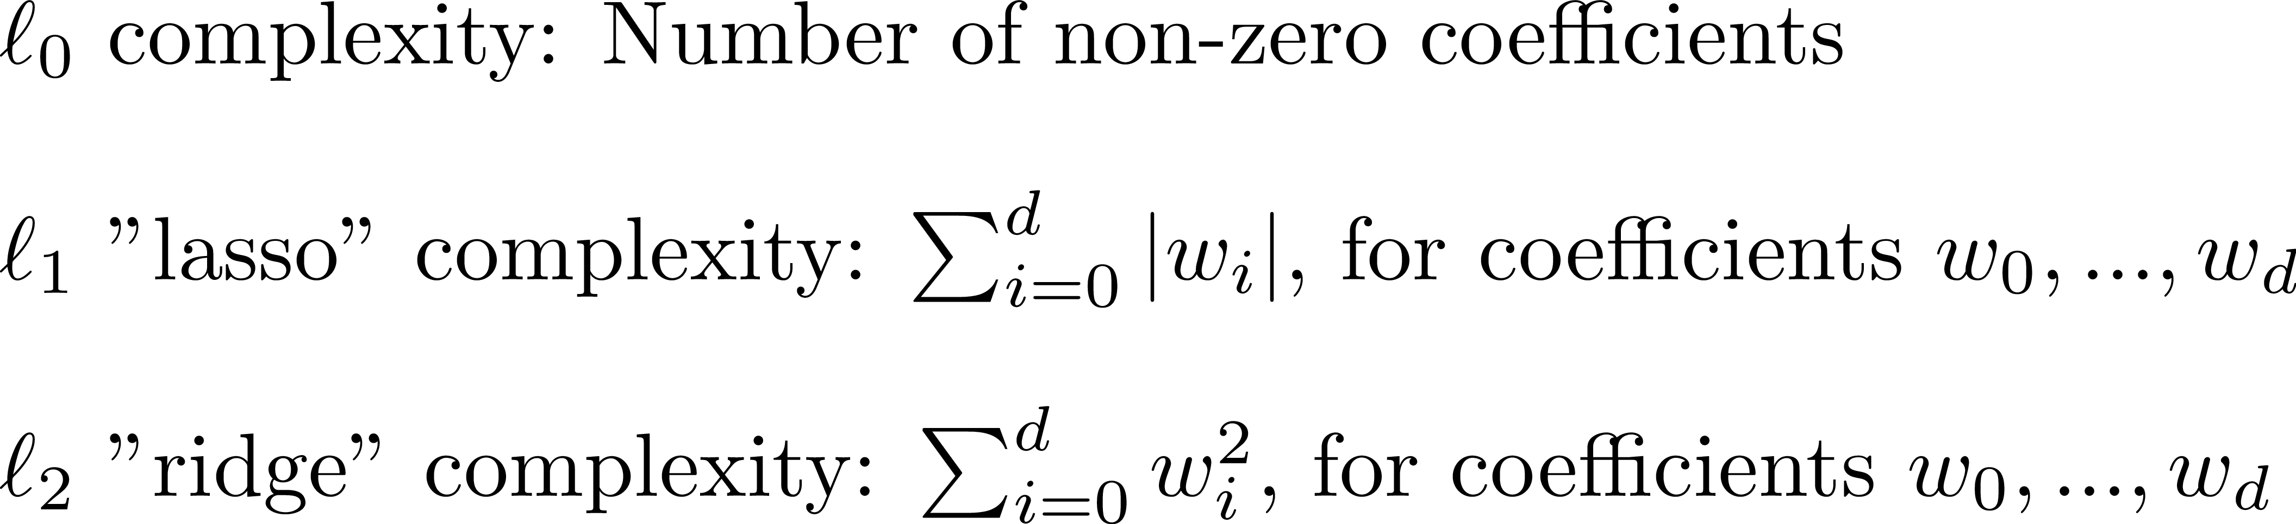
Feedforward Neural Networks
Model Complexity
SGD, Epochs, Batches and Steps
Activation functions
SGD learning rate
Other optimization methods
Regularization
Normalizing inputs
Vanishing/Exploding Gradients
Weights initialization

Slide 22
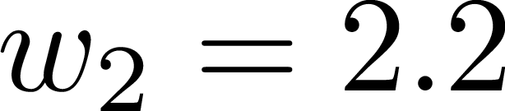
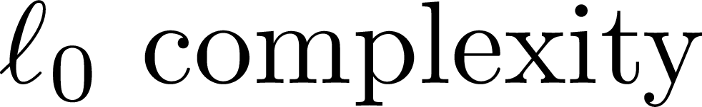
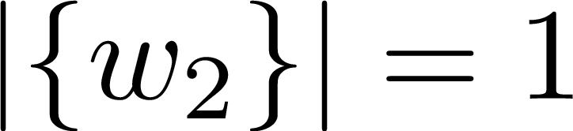
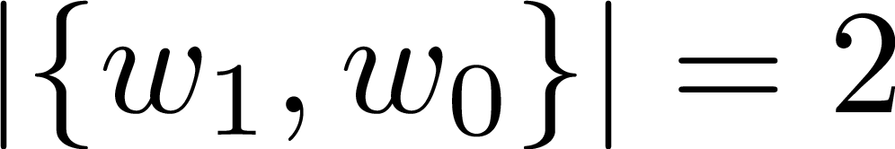
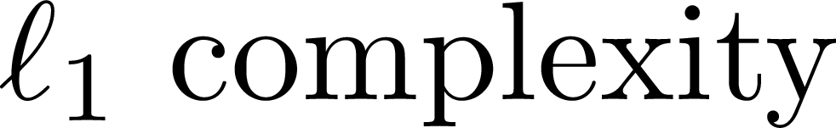
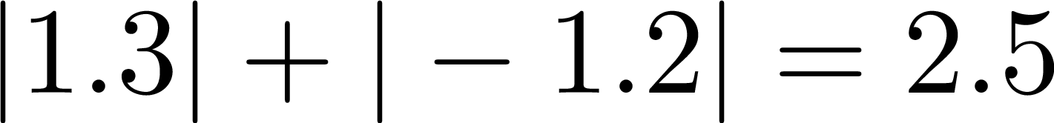
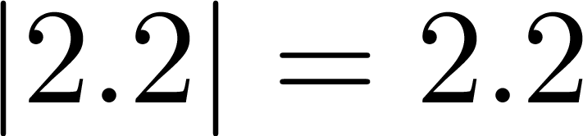
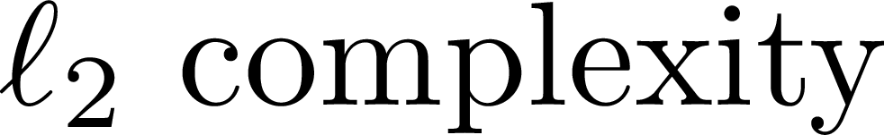
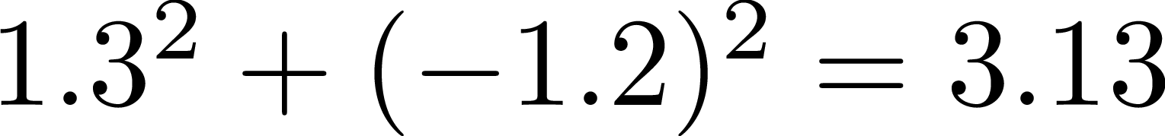
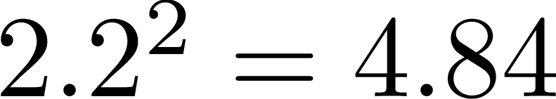
Feedforward Neural Networks
Model Complexity
SGD, Epochs, Batches and Steps
Activation functions
SGD learning rate
Other optimization methods
Regularization
Normalizing inputs
Vanishing/Exploding Gradients
Weights initialization

Slide 23
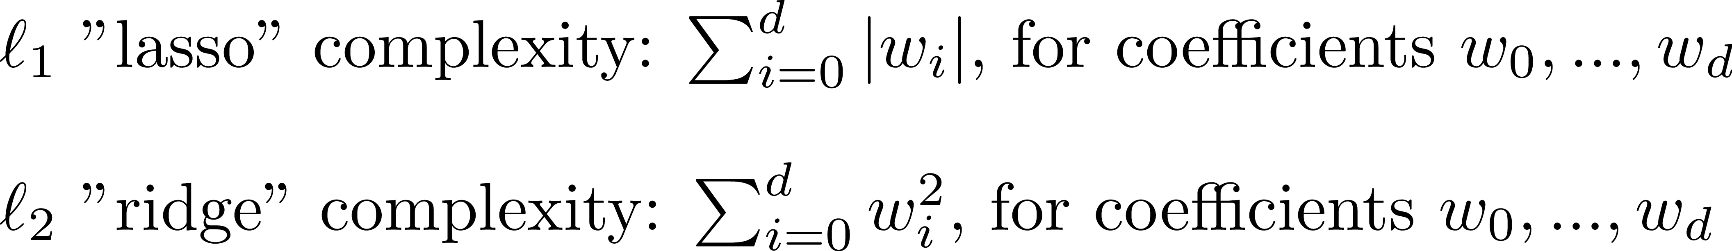
Feedforward Neural Networks
L1 / L2 Regularization
SGD, Epochs, Batches and Steps
Activation functions
SGD learning rate
Other optimization methods
Regularization
Normalizing inputs
Vanishing/Exploding Gradients
Weights initialization
What complexities do these methods use?

Slide 24
A bit of History

Slide 25

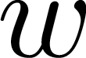
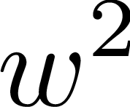
Feedforward Neural Networks
L1 / L2 Regularization
L1 Penalty
SGD, Epochs, Batches and Steps
Activation functions
SGD learning rate
Other optimization methods
Regularization
Normalizing inputs
Vanishing/Exploding Gradients
Weights initialization
L2 Penalty

Slide 26

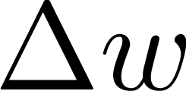
Feedforward Neural Networks
L1 / L2 Regularization
L1 Penalty
SGD, Epochs, Batches and Steps
Activation functions
SGD learning rate
Other optimization methods
Regularization
Normalizing inputs
Vanishing/Exploding Gradients
Weights initialization
L2 Penalty

Slide 27
Feedforward Neural Networks
Dropout
Step n
SGD, Epochs, Batches and Steps
Activation functions
SGD learning rate
Other optimization methods
Regularization
Normalizing inputs
Vanishing/Exploding Gradients
Weights initialization
Dropout 50%
Dropout 50%

Slide 28
Feedforward Neural Networks
Dropout
Step n+1
SGD, Epochs, Batches and Steps
Activation functions
SGD learning rate
Other optimization methods
Regularization
Normalizing inputs
Vanishing/Exploding Gradients
Weights initialization
Dropout 50%
Dropout 50%

Slide 29
Feedforward Neural Networks
Dropout
Step n+2
SGD, Epochs, Batches and Steps
Activation functions
SGD learning rate
Other optimization methods
Regularization
Normalizing inputs
Vanishing/Exploding Gradients
Weights initialization
Dropout 50%
Dropout 50%

Slide 30
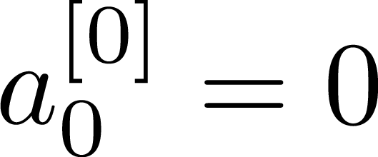
Feedforward Neural Networks
Dropout
SGD, Epochs, Batches and Steps
Activation functions
SGD learning rate
Other optimization methods
Regularization
Normalizing inputs
Vanishing/Exploding Gradients
Weights initialization
Before drop-out:
After drop-out:
What complexity does this method use?

Slide 31
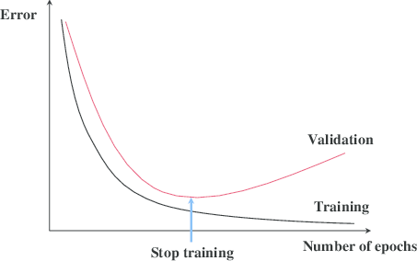
Feedforward Neural Networks
Early Stopping
SGD, Epochs, Batches and Steps
Activation functions
SGD learning rate
Other optimization methods
Regularization
Normalizing inputs
Vanishing/Exploding Gradients
Weights initialization

Slide 32

Feedforward Neural Networks
Early Stopping
SGD, Epochs, Batches and Steps
Activation functions
SGD learning rate
Other optimization methods
Regularization
Normalizing inputs
Vanishing/Exploding Gradients
Weights initialization

Slide 33
Feedforward Neural Networks
Early Stopping
SGD, Epochs, Batches and Steps
Activation functions
SGD learning rate
Other optimization methods
Regularization
Normalizing inputs
Vanishing/Exploding Gradients
Weights initialization
What complexity does this method use?

Slide 34
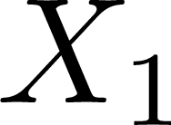
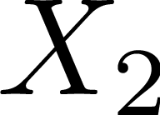
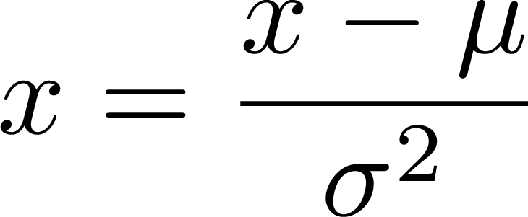
Feedforward Neural Networks
SGD, Epochs, Batches and Steps
Activation functions
SGD learning rate
Other optimization methods
Regularization
Normalizing inputs
Vanishing/Exploding Gradients
Weights initialization

Slide 35
Feedforward Neural Networks
SGD, Epochs, Batches and Steps
Activation functions
SGD learning rate
Other optimization methods
Regularization
Normalizing inputs
Vanishing/Exploding Gradients
Weights initialization

Slide 36
Feedforward Neural Networks
Variance
SGD, Epochs, Batches and Steps
Activation functions
SGD learning rate
Other optimization methods
Regularization
Normalizing inputs
Vanishing/Exploding Gradients
Weights initialization
Variance

Slide 37
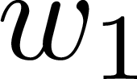
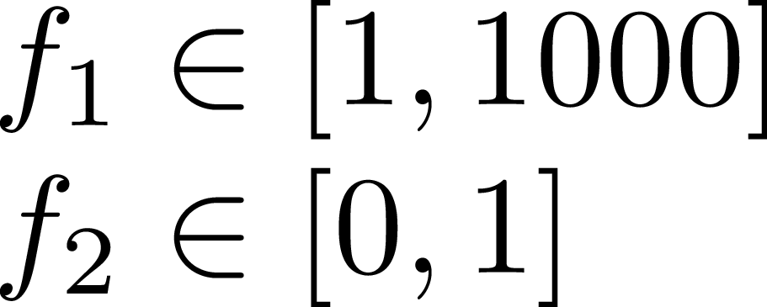
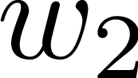
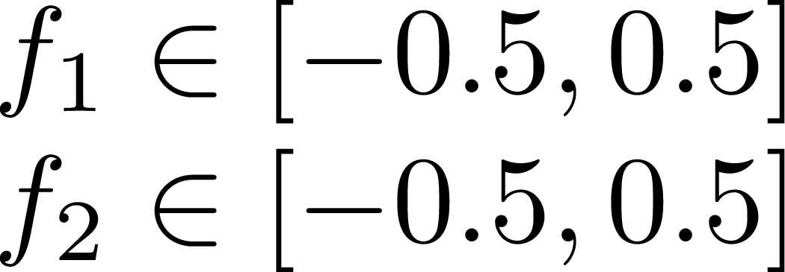
Feedforward Neural Networks
Why input normalization matters?
Unnormalized loss space
SGD, Epochs, Batches and Steps
Activation functions
SGD learning rate
Other optimization methods
Regularization
Normalizing inputs
Vanishing/Exploding Gradients
Weights initialization
Normalized loss space

Slide 38
Feedforward Neural Networks
Why input normalization matters?
Unnormalized loss space
SGD, Epochs, Batches and Steps
Activation functions
SGD learning rate
Other optimization methods
Regularization
Normalizing inputs
Vanishing/Exploding Gradients
Weights initialization
Normalized loss space

Slide 39
Feedforward Neural Networks
SGD, Epochs, Batches and Steps
Activation functions
SGD learning rate
Other optimization methods
Regularization
Normalizing inputs
Vanishing/Exploding Gradients
Weights initialization
Input
Output

Slide 40

Feedforward Neural Networks
$$W^{0}$$
SGD, Epochs, Batches and Steps
Activation functions
SGD learning rate
Other optimization methods
Regularization
Normalizing inputs
Vanishing/Exploding Gradients
Weights initialization
Input
Output

Slide 41
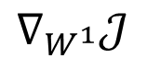
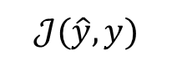
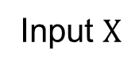
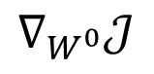
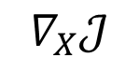
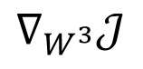

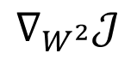
Feedforward Neural Networks
$$W^{0}$$
Feed Forward
$$\hat{y}$$
Input $X$
SGD, Epochs, Batches and Steps
Activation functions
SGD learning rate
Other optimization methods
Regularization
Normalizing inputs
Vanishing/Exploding Gradients
Weights initialization
Backpropagation
$$∇_{X}𝒥$$
$$𝒥(\hat{y}, y)$$
$$∇_{W^{0}}𝒥$$
$$∇_{W^{1}}𝒥$$
$$∇_{W^{2}}𝒥$$
$$∇_{W^{3}}𝒥$$

Slide 42
Feedforward Neural Networks
$$W^{0}$$
Feed Forward
$$\hat{y}$$
Input $X$
SGD, Epochs, Batches and Steps
Activation functions
SGD learning rate
Other optimization methods
Regularization
Normalizing inputs
Vanishing/Exploding Gradients
Weights initialization
Backpropagation
$$∇_{X}𝒥$$
$$𝒥(\hat{y}, y)$$
$$∇_{W^{0}}𝒥$$
$$∇_{W^{1}}𝒥$$
$$∇_{W^{2}}𝒥$$
$$∇_{W^{3}}𝒥$$

Slide 43
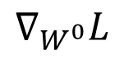
Feedforward Neural Networks
$$W^{0}$$
Weights get stucked!
0.42 → 0.419999
SGD, Epochs, Batches and Steps
Activation functions
SGD learning rate
Other optimization methods
Regularization
Normalizing inputs
Vanishing/Exploding Gradients
Weights initialization
$$∇_{W^{0}}L$$

Slide 44
Feedforward Neural Networks
Why gradients get smaller and smaller at each layer on backpropagation?
SGD, Epochs, Batches and Steps
Activation functions
SGD learning rate
Other optimization methods
Regularization
Normalizing inputs
Vanishing/Exploding Gradients
Weights initialization
$$∇_{W^{0}}𝒥$$
$$∇_{W^{1}}𝒥$$
$$∇_{W^{2}}𝒥$$
$$∇_{W^{3}}𝒥$$

Slide 45
Feedforward Neural Networks
Why gradients get smaller and smaller at each layer on backpropagation?
Well, this is related to the derivatives chain rule.
SGD, Epochs, Batches and Steps
Activation functions
SGD learning rate
Other optimization methods
Regularization
Normalizing inputs
Vanishing/Exploding Gradients
Weights initialization
$$∇_{W^{0}}𝒥$$
$$∇_{W^{1}}𝒥$$
$$∇_{W^{2}}𝒥$$
$$∇_{W^{3}}𝒥$$

Slide 46
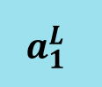
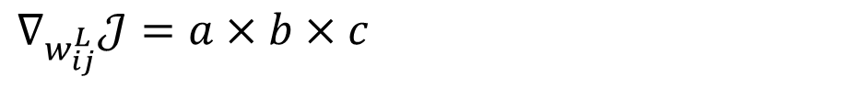
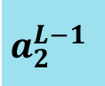
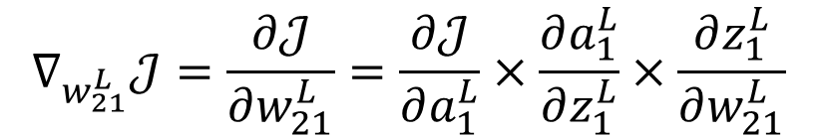
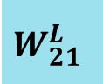
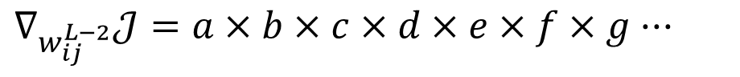

Feedforward Neural Networks
Why gradients get smaller and smaller at each layer on backpropagation?
$$∇_{w_{21}^{L}}𝒥=\frac{∂𝒥}{∂w_{21}^{L}}=\frac{∂𝒥}{∂a_{1}^{L}}×\frac{∂a_{1}^{L}}{∂z_{1}^{L}}×\frac{∂z_{1}^{L}}{∂w_{21}^{L}}$$
$$a_{2}^{L−1}$$
$$W_{21}^{L}$$
SGD, Epochs, Batches and Steps
Activation functions
SGD learning rate
Other optimization methods
Regularization
Normalizing inputs
Vanishing/Exploding Gradients
Weights initialization
$$a_{1}^{L}$$
$$∇_{w_{ij}^{L}}𝒥=a×b×c$$
$$∇_{w_{ij}^{L−1}}𝒥=a×b×c×d×e×f$$
$$∇_{w_{ij}^{L−2}}𝒥=a×b×c×d×e×f×g···$$

Slide 47



Feedforward Neural Networks
Why gradients get smaller and smaller at each layer on backpropagation?
$$∇_{w_{ij}^{L}}𝒥=a×b×c$$
$$∇_{w_{ij}^{L−1}}𝒥=a×b×c×d×e×f$$
$$∇_{w_{ij}^{L−2}}𝒥=a×b×c×d×e×f×g···$$
SGD, Epochs, Batches and Steps
Activation functions
SGD learning rate
Other optimization methods
Regularization
Normalizing inputs
Vanishing/Exploding Gradients
Weights initialization
Terms values < 1.0
+
#Multypling terms
=
$$∇_{W^{0}}𝒥$$
$$∇_{W^{1}}𝒥$$
$$∇_{W^{2}}𝒥$$
$$∇_{W^{3}}𝒥$$

Slide 48
Feedforward Neural Networks
What about exploding gradients?
$$∇_{w_{ij}^{L}}𝒥=a×b×c$$
$$∇_{w_{ij}^{L−1}}𝒥=a×b×c×d×e×f$$
$$∇_{w_{ij}^{L−2}}𝒥=a×b×c×d×e×f×g···$$
SGD, Epochs, Batches and Steps
Activation functions
SGD learning rate
Other optimization methods
Regularization
Normalizing inputs
Vanishing/Exploding Gradients
Weights initialization
Terms values > 1.0
+
#Multypling terms
=
$$∇_{W^{0}}𝒥$$
$$∇_{W^{1}}𝒥$$
$$∇_{W^{2}}𝒥$$
$$∇_{W^{3}}𝒥$$

Slide 49










Feedforward Neural Networks
$$W_{·3}^{l}$$
Normal Distribution
$$N(μ=0,σ^{2}=1)$$
$$a_{0}^{l−1}$$
$$a_{1}^{l−1}$$
0.48
-1.83
$$a_{2}^{l−1}$$
-0.37
SGD, Epochs, Batches and Steps
Activation functions
SGD learning rate
Other optimization methods
Regularization
Normalizing inputs
Vanishing/Exploding Gradients
Weights initialization
$$a_{3}^{l−1}$$
-0.11
$$Z_{i}^{l}$$
0.43
$$a_{N}^{l−1}$$
$$N=200$$

Slide 50
Feedforward Neural Networks
$$W_{·3}^{l}$$
Normal Distribution
$$N(μ=0,σ^{2}=1)$$
1
1
0.48
-1.83
1
-0.37
SGD, Epochs, Batches and Steps
Activation functions
SGD learning rate
Other optimization methods
Regularization
Normalizing inputs
Vanishing/Exploding Gradients
Weights initialization
1
-0.11
$$Z_{i}^{l}$$
0.43
1
$$N=200$$

Slide 51




Feedforward Neural Networks
Sum of independent random variables that are normally distributed:
$$W_{·3}^{l}$$
1
$$X\sim N(μ_{X},{σ^{2}}_{X})$$
1
0.48
$$Y\sim N(μ_{Y},{σ^{2}}_{Y})$$
-1.83
$$Z=X+Y$$
1
-0.37
SGD, Epochs, Batches and Steps
Activation functions
SGD learning rate
Other optimization methods
Regularization
Normalizing inputs
Vanishing/Exploding Gradients
Weights initialization
1
-0.11
$$Z_{i}^{l}$$
$$Z\sim N(μ_{X}+μ_{Y},{σ^{2}}_{X}+{σ^{2}}_{Y})$$
0.43
1
$$N=200$$

Slide 52



Feedforward Neural Networks
Sum of independent random variables that are normally distributed:
$$W_{·3}^{l}$$
1
$$X\sim N(μ_{X},{σ^{2}}_{X})$$
1
0.48
$$Y\sim N(μ_{Y},{σ^{2}}_{Y})$$
-1.83
$$Z=X+Y$$
1
-0.37
SGD, Epochs, Batches and Steps
Activation functions
SGD learning rate
Other optimization methods
Regularization
Normalizing inputs
Vanishing/Exploding Gradients
Weights initialization
1
-0.11
$$Z_{i}^{l}$$
$$Z\sim N(μ_{X}+μ_{Y},{σ^{2}}_{X}+{σ^{2}}_{Y})$$
$$μ\left(z_{i}^{l}\right)=0.0$$
0.43
$$σ\left(z_{i}^{l}\right)=\sqrt{200}≈14.14$$
1
$$N=200$$

Slide 53


Feedforward Neural Networks
$$W_{·3}^{l}$$
$$sigmoid(x)=\frac{e^{x}}{e^{x}+1}$$
1
1
0.48
-1.83
1
-0.37
SGD, Epochs, Batches and Steps
Activation functions
SGD learning rate
Other optimization methods
Regularization
Normalizing inputs
Vanishing/Exploding Gradients
Weights initialization
1
-0.11
$$Z_{i}^{l}$$
$$μ\left(z_{i}^{l}\right)=0.0$$
0.43
$$σ\left(z_{i}^{l}\right)=\sqrt{200}≈14.14$$
1
$$N=200$$

Slide 54
Feedforward Neural Networks
$$W_{·3}^{l}$$
1
1
???
???
Alternative weights initializations?
1
???
SGD, Epochs, Batches and Steps
Activation functions
SGD learning rate
Other optimization methods
Regularization
Normalizing inputs
Vanishing/Exploding Gradients
Weights initialization
1
???
$$Z_{i}^{l}$$
???
1
$$N=200$$

Slide 55

Feedforward Neural Networks
Truncated Normal Initialization
$$W_{·3}^{l}$$
1
Normal Distribution
$$N(μ=0,σ^{2}=1)$$
1
???
???
1
???
SGD, Epochs, Batches and Steps
Activation functions
SGD learning rate
Other optimization methods
Regularization
Normalizing inputs
Vanishing/Exploding Gradients
Weights initialization
1
???
$$Z_{i}^{l}$$
???
1
$$N=200$$

Slide 56

Feedforward Neural Networks
Truncated Normal Initialization
$$W_{·3}^{l}$$
1
Normal Distribution
$$N(μ=0,σ^{2}=1)$$
1
???
???
1
???
SGD, Epochs, Batches and Steps
Activation functions
SGD learning rate
Other optimization methods
Regularization
Normalizing inputs
Vanishing/Exploding Gradients
Weights initialization
1
???
$$Z_{i}^{l}$$
???
1
$$N=200$$

Slide 57
Feedforward Neural Networks
Truncated Normal Initialization
$$W_{·3}^{l}$$
1
Normal Distribution
$$N(μ=0,σ^{2}=1)$$
1
0.48
-1.83
1
-0.37
SGD, Epochs, Batches and Steps
Activation functions
SGD learning rate
Other optimization methods
Regularization
Normalizing inputs
Vanishing/Exploding Gradients
Weights initialization
1
-0.11
$$Z_{i}^{l}$$
0.43
1
$$N=200$$

Slide 58

Feedforward Neural Networks
Truncated Normal Initialization
$$W_{·3}^{l}$$
1
Normal Distribution
$$N(μ=0,σ^{2}=1)$$
1
0.48
-1.83
1
-0.37
SGD, Epochs, Batches and Steps
Activation functions
SGD learning rate
Other optimization methods
Regularization
Normalizing inputs
Vanishing/Exploding Gradients
Weights initialization
1
-0.11
$$Z_{i}^{l}$$
0.43
1
$$N=200$$

Slide 59
Feedforward Neural Networks
Truncated Normal Initialization
$$W_{·3}^{l}$$
1
Normal Distribution
$$N(μ=0,σ^{2}=1)$$
1
0.48
0.25
1
-0.37
SGD, Epochs, Batches and Steps
Activation functions
SGD learning rate
Other optimization methods
Regularization
Normalizing inputs
Vanishing/Exploding Gradients
Weights initialization
1
-0.11
$$Z_{i}^{l}$$
0.43
1
$$N=200$$

Slide 60



Feedforward Neural Networks
Xavier / Glorot Initialization
$$W_{·3}^{l}$$
1
1
???
$$μ\left(z_{i}^{l}\right)=0.0$$
???
$$σ\left(z_{i}^{l}\right)=1.0$$
1
???
SGD, Epochs, Batches and Steps
Activation functions
SGD learning rate
Other optimization methods
Regularization
Normalizing inputs
Vanishing/Exploding Gradients
Weights initialization
1
???
$$Z_{i}^{l}$$
$$σ^{2}\left(W_{·3}^{l}\right)=\frac{1}{N}=0.005$$
???
1
$$σ\left(W_{·3}^{l}\right)= \sqrt{1/N}≈0.0707$$
$$N=200$$

Slide 61


Feedforward Neural Networks
Xavier / Glorot Initialization
$$W_{·3}^{l}$$
1
Normal Distribution
$$N(μ=0,σ^{2}=0.005)$$
1
???
???
1
???
SGD, Epochs, Batches and Steps
Activation functions
SGD learning rate
Other optimization methods
Regularization
Normalizing inputs
Vanishing/Exploding Gradients
Weights initialization
1
???
$$Z_{i}^{l}$$
???
1
$$N=200$$

Slide 62
Practical Aspects

Slide 63
Practical Aspects
Dataset
Train
Validation
Test
Train
Set used to train & control bias
Train / Validation / Test
Workflow
Validation
Set used to control variance
Set used to estimate the generalization error of the final model
Test

Slide 64

Practical Aspects
Dataset
Train
Validation
Test
Train
Set used to train & control bias
Train / Validation / Test
Workflow
Validation
Set used to control variance
Set used to estimate the generalization error of the final model
Test

Slide 65
Practical Aspects
Dataset
Train
Test
Train
Set used to train & control bias
Train / Validation / Test
Workflow
Test
Set used to control variance
Set used to estimate the generalization error of the final model
Test

Slide 66
Practical Aspects
Machine Learning
80%
10%
10%
How many images do we need for each set?
Train / Validation / Test
Workflow
Train
As many as possible
The minimum amount to appropriately represent each class
Validation
The minimum amount to appropriately represent each class
Test

Slide 67
Practical Aspects
Machine Learning
80%
10%
10%
Typical dataset size: 1.000 - 30.000
Train / Validation / Test
Workflow
Deep Learning
99%
Typical dataset size: 30.000 - 10.000.000

Slide 68

Practical Aspects
Train / Validation / Test
Workflow

Slide 69

Practical Aspects
Train / Validation / Test
Workflow

Slide 70
Practical Aspects
Get ideas
Implement them
Experiment
Lots of hyper-parameters:
Network architecture:
# layers
# neurons
Activation function
Learning rate
Optimization algorithm
...
Train / Validation / Test
Workflow

Slide 71
Practical Aspects
Train longer
Increase model’s capacity:
More layers
More hidden neurons
Search for architecture suitable for your data structure
Preprocessing data to simplify the task
Reduce high bias
Train / Validation / Test
Workflow
More data
Data Augmentation
Regularization
Search for architecture suitable for your data structure
Reduce high variance

Slide 72
Convolutional Neural Networks

Slide 73


Convolutional Neural Networks
Some data has spatial correlations that could be exploited:
Near-by data points are more strongly related than far-away ones.
Holds for 1D (seq), 2D (mat), 3D (vol), ...
If we can sparsify connectivity following a consistent purpose, we may reduce complexity and ease the learning of more coherent patterns
Limited connectivity
Convolution & weight sharing
Filters
Kernel size, stride and padding
Convolutional volumes
Pooling layers
Convolutional architectures
CNNs from the inside
CNN Applications

Slide 74

Convolutional Neural Networks
Sparse connectivity is nice, but we still want to apply filters everywhere.
Each limited connectivity pattern (a kernel) will get convolved all over the image, generating a number of values.
Notice each kernel generates a 2D matrix of values.
Limited connectivity
Convolution & weight sharing
Filters
Kernel size, stride and padding
Convolutional volumes
Pooling layers
Convolutional architectures
CNNs from the inside
CNN Applications
In practice we have sets of neurons sharing weights

Slide 75


Convolutional Neural Networks
Convolution kernels can do all sorts of things on an image:
Limited connectivity
Convolution & weight sharing
Filters
Kernel size, stride and padding
Convolutional volumes
Pooling layers
Convolutional architectures
CNNs from the inside
CNN Applications
Let's let the model learn them

Slide 76


Convolutional Neural Networks
Kernel size: Size of the receptive field of convolutional neurons. Typically 3x3, 5x5, 7x7
Stride: Number of steps while convolving filter.
Stride 1 the most common. Larger strides can replace pooling.
Padding: Border added to center conv. everywhere
No padding: Dimensionality reduced
Most common, zero equal/same padding
Limited connectivity
Convolution & weight sharing
Filters
Kernel size, stride and padding
Convolutional volumes
Pooling layers
Convolutional architectures
CNNs from the inside
CNN Applications

Slide 77


Convolutional Neural Networks
In a typical 2D CNN, conv filters are 3D (full depth).
Each filter convolved generates a 2D plane of data.
Depth provides all the neural views on a part of data
Limited connectivity
Convolution & weight sharing
Filters
Kernel size, stride and padding
Convolutional volumes
Pooling layers
Convolutional architectures
CNNs from the inside
CNN Applications

Slide 78


Convolutional Neural Networks
Pooling:
Small spatial invariance
Dimensionality reduction (along x and y only)
Never applied full depth!
Parameter free layer
Hyperparams:
Size & Stride
Loss in precision
Max >> Avg
Limited connectivity
Convolution & weight sharing
Filters
Kernel size, stride and padding
Convolutional volumes
Pooling layers
Convolutional architectures
CNNs from the inside
CNN Applications

Slide 79

Convolutional Neural Networks
The first influential architecture was AlexNet:
5 layers using convs, pools, ReLU, 2 dense, and dropout.
62M parameters
VGG16/19 extends the (conv-pool)*dense design:
Smaller, 3x3 filters, but more
138M parameters
Some design principles: KISS, be repetitive & pyramidal
Limited connectivity
Convolution & weight sharing
Filters
Kernel size, stride and padding
Convolutional volumes
Pooling layers
Convolutional architectures
CNNs from the inside
CNN Applications
Bigger is not better!
[AlexNet,12]
[VGG,14]

Slide 80




Convolutional Neural Networks
But deeper should never be worse!
In theory, yes. In practice, identity is hard to learn
ResNet: Learning zero is easier than learning id.
We can now train a 1K layer net
DenseNet: link all to all
Use depth concats
1x1 convs to make it feasible
Inception: how to fix filter size?
Let the net decide which is best
Avg. Pooling instead of dense
Limited connectivity
Convolution & weight sharing
Filters
Kernel size, stride and padding
Convolutional volumes
Pooling layers
Convolutional architectures
CNNs from the inside
CNN Applications
[Inception,15]
[ResNet,16]
[Huang,16]
[Xu,WWW]

Slide 81

Convolutional Neural Networks
Different architectures that can be done...
Convolution – Transposed convolution (pixel-wise)
Limited connectivity
Convolution & weight sharing
Filters
Kernel size, stride and padding
Convolutional volumes
Pooling layers
Convolutional architectures
CNNs from the inside
CNN Applications

Slide 82



Convolutional Neural Networks
What do filters learn?
Limited connectivity
Convolution & weight sharing
Filters
Kernel size, stride and padding
Convolutional volumes
Pooling layers
Convolutional architectures
CNNs from the inside
CNN Applications

Slide 83


Convolutional Neural Networks
Style transfer
Limited connectivity
Convolution & weight sharing
Filters
Kernel size, stride and padding
Convolutional volumes
Pooling layers
Convolutional architectures
CNNs from the inside
CNN Applications
Multimodal pipelines
[Gatys,15]
[Kiros,14]

Slide 84



Convolutional Neural Networks
Image colorization
Limited connectivity
Convolution & weight sharing
Filters
Kernel size, stride and padding
Convolutional volumes
Pooling layers
Convolutional architectures
CNNs from the inside
CNN Applications
Image segmentation
[Zhang,16]
[Iizuka,16]
[Chen,16]

Slide 86

Deep Neural Networks

Slide 87



Deep Neural Networks
Aprenentatge

Slide 88


Deep Neural Networks

Slide 89
Neural Networks
$$W^{0}$$
$$W^{1}$$
$$W^{2}$$
$$a_{0}^{0}$$
$$z_{0}^{0}$$
$$a_{0}^{0}$$
$$z_{0}^{0}$$
$$a_{0}^{0}$$
Forward pass
Batching
Activation funcions
Gradient Descent on NNs
Backpropagation
$$a_{0}^{0}$$
$$z_{0}^{0}$$
$$a_{0}^{0}$$
$$z_{0}^{0}$$
$$a_{0}^{0}$$
$$z_{0}^{0}$$
$$a_{0}^{0}$$
$$x^{(i)}$$
$$a_{0}^{0}$$
$$\hat{y}$$
$$z_{0}^{0}$$
$$a_{0}^{0}$$
$$z_{0}^{0}$$
$$a_{0}^{0}$$
$$z_{0}^{0}$$
$$a_{0}^{0}$$
$$a_{0}^{0}$$
$$z_{0}^{0}$$
$$a_{0}^{0}$$
$$z_{0}^{0}$$
$$a_{0}^{0}$$
$$a_{0}^{0}$$
h

Slide 90

NNs to Deep Learning
Ferran Parés

